Slide 1
Chapter 19 Standard Template Library
Instructor Name: Geetika Gautam

Slide 2
STL
The Containers library is a generic collection of class templates and algorithms that allow programmers to easily implement common data structures like vector, queues, lists and stacks.
Reusability of Software
Separation of Functionality

Slide 3
STL
Containers
Containers are used to manage collections of objects of a certain kind. There are several different types of containers like deque, list, vector, map etc.
Algorithms
Algorithms act on containers. They provide the means by which you will perform initialization, sorting, searching, and transforming of the contents of containers.
Iterators
Iterators are used to step through the elements of collections of objects. These collections may be containers or subsets of containers.

Slide 4
Container
Containers are the objects used to store multiple elements of the same type or different. Depending on that they can be further classified as −
Sequence containers (vector, list,deque)
Associative containers (set, map, multimap)
Unordered Associative containers (unordered_set, unordered_map)
Container Adapters (stack, queue)

Slide 5
Algorithm
Algorithms are operations that we need to apply to the container elements.
They are divided into four categories:
non-mutating algorithms that do not change the container structure.
mutating algorithms that change the structure
sorting algorithms that reorder elements in a container
numeric algorithms that apply mathematical operations on the elements.

Slide 6
Iterator
Operations we need to perform on the elements of a container are independent from the type of the element and the type of the container.
We need to access the elements in the container one by one.
The iterators allow us to access each element individually and apply the desired operation to it.
Input Iterator. An input iterator can use the dereference operator only to read from a container; it is not allowed to write to it. In other words, an input iterator treats the container as a source of data items to read.
Output Iterator. An output iterator can use the dereference operator to only write to a container; it is not allowed to read from it.
Forward Iterator. A forward iterator can read or write elements. Its functionality is the combination of the input and output iterator.
Bidirectional Iterator. A bidirectional iterator can move in both directions: backward and forward. The ++ and −− operators are defined for this iterator.
Random-Access Iterator. A random-access iterator has the capabilities of a bidirectional iterator, and in addition it supports the add (+) operator and the subtract operator (−). It also provides four relational operators (<, <=, >, and >=) that are not provided by the other iterators.

Slide 7
Supported operations for iterators
Iterator | read | Write | * | ++ | −− | == != | <, <=, >, >= | + −
input | √ |  | √ | √ |  | √
output |  | √ | √ | √ |  | √
forward | √ | √ | √ | √ |  | √
bidirectional | √ | √ | √ | √ | √ | √
random-access | √ | √ | √ | √ | √ | √ | √ | √

Slide 8
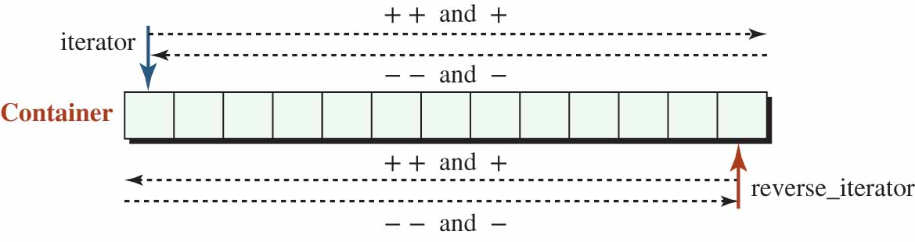
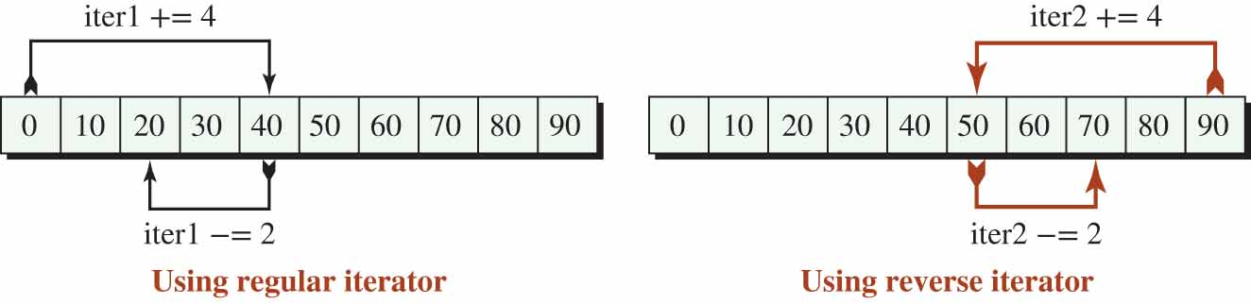
Moving Direction
A container normally defines two categories of iterators: regular (called iterator) and reverse (called reverse_iterator).
Moving directions of a regular and a reverse iterator

Slide 9
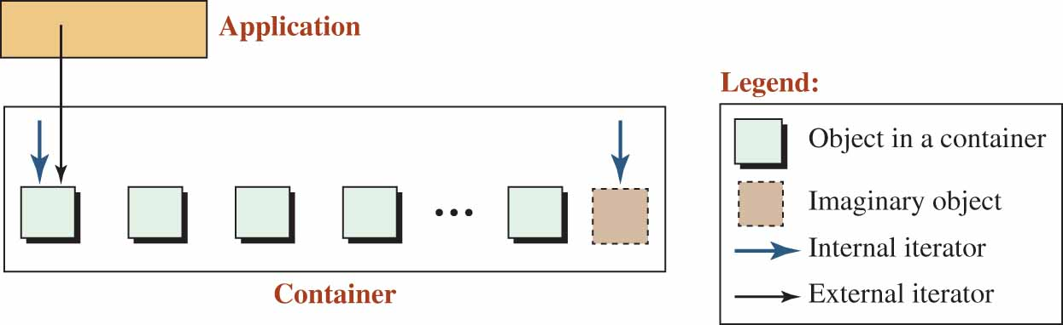
Internal and external iterator
The left internal iterator is pointing to the first object in the container.
The external iterator is initialized to point where the left internal iterator is pointing.
The application can move the external iterator through the container until it reaches the right internal iterator, which is pointing to a non-existent object at the end.

Slide 10
Sequence Container
A sequence container is a collection of objects in which the programmer controls the order of storing and retrieving elements.
The STL provides three sequence containers: vector, deque, and list.
The first two are normally implemented as dynamic arrays; the third is normally implemented as a doubly linked list.
Vector
When array limitation like declaring an array, passing size of an array is compulsory, and the size must be a constant that can be removed by Vector.
Syntax
vector <data type> vector name;
vector<int> vector1 = {1, 2, 3, 4, 5};
vector<int> vector2 {1, 2, 3, 4, 5};
vector<int> vector3(5, 12); //5 size and 12 value

Slide 11
Size and Capacity.
The vector class has six member functions related to the size and capacity of a vector.
Accessing Elements (for retrieve or change).
The vector class provides the following member functions to access elements already in the vector.
vec.front();
vec.back();
vec [i];
vec.at(i);
// Access the first element
// Access the last element
// Access the element at index i
// Access the element at index i
Iterators
The vector class defines two regular iterators and two reverse iterators

Slide 12
Vector class
To use iterators in our program, we need first to instantiate them.
Since each container has its own iterators, we need to create one or both of the iterators for that specific class as needed.
vector <T> :: iterator iter; // A regular iterator
vector <T> :: reverse_iterator riter; // A reverse iterator
After instantiation of the user iterators, we need to set them.
The iterator iter needs to start where the iterator returned from begin() is set; we need to set the iterator riter to where the iterator returned from rbegin() is set as shown below:
iter = vec.begin(); // iter starts when the vec.begin() points to
riter = vec.rbegin(); // riter starts when the vec.rbegin() points to

Slide 13
Example
#include <iostream>
#include <vector>
using namespace std;
int main()
{
vector<int> vec;
vec.push_back(100);
vec.push_back(101);
vec.push_back(103);
cout<<vec[0]<<endl;
cout<<vec[1]<<endl;
cout<<vec.front()<<endl;
cout<<vec.back()<<endl;
cout<<vec.at(1)<<endl;
vector<int>:: iterator it; // like a pointer to point the values (pointer generate)
it=vec.begin(); //pointing in the begin
cout<<*it<<endl;
vector<int>:: reverse_iterator itt;
itt=vec.rbegin(); //pointing in the end;
cout<<*itt;
vec.pop_back();
return 0;
}

Slide 14
#include <vector>
#include <iostream>
#include <iomanip>
using namespace std;
int main()
{
// Constructing a vector of 10 elements and two iterators
vector <int> vec(10);
vector <int> :: iterator iter;
vector <int> :: reverse_iterator rIter;
// Changing the value of elements
for (int i = 0; i < 10; i++)
{
vec.at(i) = i * i;
}
// Printing the elements using the forward iterator
cout << "Regular navigation: ";
for (iter = vec.begin() ; iter != vec.end() ; ++iter)
{. cout << setw(4) << *iter;
}
cout << endl;
// Printing the elements using reverse iterator
cout << "Reverse navigation: ";
for (rIter = vec.rbegin() ; rIter != vec.rend() ; ++rIter)
{
cout << setw(4) << *rIter;
}
cout << endl;
return 0;
}

Slide 15
A program to simulate a table using a vector of vectors
#include <vector>
#include <iostream>
#include <iomanip>
using namespace std;
int main() {
// Creation of a vector of vectors
int rows = 10;
int cols = 10;
vector < vector <int> > table(rows, vector <int>(cols));
// Changing values from default
for (int i = 0; i < rows ; i++)
{
for (int j = 0 ; j < cols; j++)
{
table [i][j] = (i + 1) * (j + 1);
} }
// Retrieving and printing values
for (int i = 0; i < rows ; i++)
{ for (int j = 0 ; j < cols; j++)
{
cout << setw(4) << table [i][j] << " "; }
cout << endl; }
return 0;
}

Slide 16
Program
Write a program to insert the 500 in the vector of 100,200,300 (after the 200)

Slide 17
Deque
The deque <T> class, defined in the <deque> header file, is a sequence container similar to a vector but with two open ends.
The name deque is short for double-ended queue.
This means that we can insert and erase at both ends of a deque
The operations for inserting and erasing elements from both ends are fast.
The deque class uses the same set of operations as the vector, but uses two additional operations.
deq.push_front(value); // Insert value at the front
deq.pop_front(); // Delete value at the front

Slide 18
int main()
{
// Create a deque of five string and print it
deque <string> deq(5);
string arr [5]= {"John", "Mary", "Rich", "Mark", "Tara"};
for (int i = 0 ; i < 5; i++)
{
deq [i] = arr [i];
}
print(deq);
// Rotate the deque clockwise one element
deq.push_back(deq.front());
deq.pop_front();
print(deq);
// Rotate the deque counter-clockwise one element
deq.push_front(deq.back());
deq.pop_back();
print(deq);
return 0;
}
#include <deque>
#include <string>
#include <iostream>
#include <iomanip>
using namespace std;
// Global print function
void print(deque <string> deq)
{
for (int i = 0; i < deq.size (); i++)
{
cout << deq.at(i) << " ";
}
cout << endl;
}

Slide 19
List Class
The list <T> class is a sequence container with fast insertion and deletion at any point.
A list does not support random access for retrieving or changing the value of an element using the index operator or the at() member function because the list is implemented as a doubly linked list.
If we want to randomly access the list, we need to use an iterator that moves to the desired element and then accesses it.

Slide 20
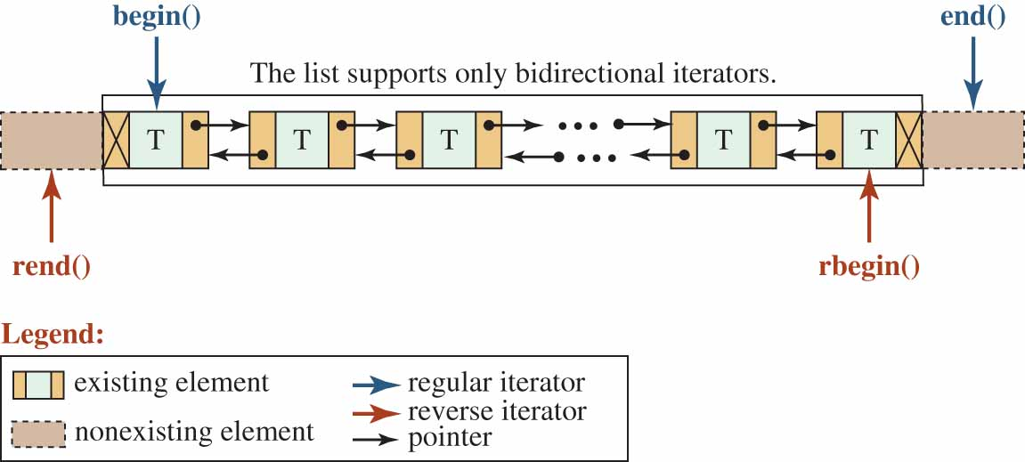

Slide 21
The capacity() and reserve() member functions do not exist in the list class because the system adds an element at the front, at the back, and in the middle using the pointers in the double linked list.
The list class provide three new operations to erase an element or elements from the list as the public interface shows.
The following shows how we call these operations.
remove(value); // Erases all occurrences of value
remove_if(predicate); // Erases all occurrences if parameter is true
unique(predicate); // Erases duplicates if parameter is true
The list class defines three other operations: splice(), merge(), and sort() as defined in the public interface.
splice(pos, first, last); // Splice [first, last)
merge(other); // Merges two sorted lists
sort(); // Sorts the list.

Slide 22
The program that creates a list of five integers and print in both forward and reverse direction
// Printing the list in forward direction
cout << "Print the list in forward direction. " << endl;
list <int> :: iterator iter1;
for(iter1 = lst.begin(); iter1 != lst.end(); iter1++)
{cout << *iter1 << " " ;
}
cout << endl;
#include <list>
#include <iostream>
using namespace std;
int main()
{
// Instantiation of a list object and declaration of a variable
list <int> lst;
int value;
// Inputting five integers and store then in the list
for (int i = 0; i < 5; i++)
{
cout << "Enter an integer: ";
cin >> value;
lst.push_back(value);
}
cout << "Print the list in reverse direction. " << endl;
list <int> :: reverse_iterator iter2;
for (iter2 = lst.rbegin(); iter2 != lst.rend(); iter2++)
{
cout << *iter2 << " " ;
}
return 0;
}

Slide 23
Link
https://www.cplusplus.com/reference/vector/vector/?kw=vector

Slide 24
Container Adapter
The standard library also defines three container adapters that have a smaller interface for easier use. The container adapters defined in the library are stack, queue, and priority_queue.
A very important point we need to remember is that, unlike containers, we cannot apply the algorithms defined in the library to container adapters because they lack iterators; they do not provide the member functions, such as begin and end, to create iterators

Slide 25
Container Adapter Classes
 | S | Q | P
size_type Ad<T> :: size() const | √ | √ | √
bool Ad <T> :: empty() const | √ | √ | √
Accessing elements
T& Ad <T> :: front() |  | √
T& Ad <T> :: back() |  | √
T& Ad <T> :: top() | √ |  | √
Insertion | S | Q | P
void Ad <T> :: push(const T& elem) | √ | √ | √
Erasure
void Ad <T> :: pop() | √ | √ | √

Slide 26
Stack Class
The stack class is a container adapter class that is designed for three simple operations: push, pop and top.
The stack class is designed for insertion to and erasure from one end (the top).
It is also referred to as a last-in, first-out or LIFO structure because the last item pushed into the stack is the first item popped from the stack

Slide 27
Converting a decimal to hexadecimal
// Creation of hexadecimal characters and push them into stack
while (decimal != 0)
{
stk.push(converter [decimal % 16]);
decimal = decimal / 16;
}
while (!stk.empty())
{
hexadecimal.push_back(stk.top());
stk.pop();
}
cout << "The hexadecimal number : " << hexadecimal;
return 0;
}
#include <stack>
#include <iostream>
using namespace std;
int main()
{
// Instantiation of a stack
stack <char> stk;
// Creation of two strings and a declaration of a variable
string converter("0123456789ABCDEF");
string hexadecimal;
int decimal;
// Inputting a decimal number
do
{
cout << "Enter a positive integer: ";
cin >> decimal;
} while (decimal <= 0);

Slide 28
Queue Class
The queue class, which is defined in the <queue> header file, is a container adapter class that is designed for three simple operations: insertion at one end, erasure from the other end, and accessing at both ends.
It is also referred to as first-in, first-out or FIFO structure because the first item pushed into the queue is the first item to be popped from the queue.

Slide 29
Priority Queue
The priority_queue class defined in the <queue> header file is a container adapter in which each element has a priority level.
The elements can be inserted into the priority_queue in any order; the elements are retrieved based on their priority.
In other words, the front element is the element with the largest priority in the container.

Slide 30
#include <queue>
#include <iostream>
using namespace std;
int main()
{ // Create a priority_queue object
priority_queue <int> line;
// Push some elements
line.push(4);
line.push(7);
line.push(2);
line.push(6);
line.push(8);
line.push(2);
while (!line.empty ())
{
cout << line.top() << " ";
line.pop();
}
return 0;
}

Slide 31
Associative Container
Unordered Associative containers (unordered_set, unordered_map)
Ordered Associative containers (set, map)
Unordered containers use hashing
Ordered container use Red Black Tree
Elements in an associative container are stored and retrieved by a key.
To access an element in an associate container, we need to use the key of the element.
Associate containers are divided into two classes (set and map).
A set is an associative container in which value has the same data item.
A map is an associative container in which the key and the value are separate data items.

Slide 32
Map
A map, which is also called a table, a dictionary, or an associate array, is defined in the <map> header file.
It is a container that stores a template pair of key and value.
The elements are sorted in ascending order based on the key.
In a map, the keys are unique.

Slide 33
Map
#include <map>
#include<iostream>
using namespace std;
int main()
{ map<int,string> name;
name[1]="abc";
name[2]="lmn";
name[3]="axyzbc";
cout<<name[2];
if(name.find(9) != name.end())
{. cout<<"found"<<endl;
}
Else
{ cout<<"not found"<<endl; }
return 0;
}

Slide 34
#include <map>
#include<iostream>
using namespace std;
int main()
{ map<int,string> name;
name[6]="abc";
name[7]="lmn";
name[8]="axyzbc";
//cout<<name[8]<<endl;
map<int,string>::iterator lt=name.begin();
for(lt;lt!= name.end();lt++)
cout<<lt->first<<":"<<lt->second<<endl;
return 0;
}

Slide 35
#include <map>
#include<iostream>
using namespace std;
int main()
{ map<int,string> name;
name[6]="abc";
name[7]="lmn";
name[8]="axyzbc";
//cout<<name[8]<<endl;
name.insert(make_pair(3,"hello"));
name.insert(make_pair(9,"hello"));
map<int,string>::iterator lt=name.begin();
for(lt; lt!= name.end();lt++)
cout<<lt->first<<":"<<lt->second<<endl;
return 0;
}

Slide 36
#include <map>
#include<iostream>
using namespace std;
int main()
{ map<int,string> name;
name[6]="abc";
name[7]="lmn";
name[8]="axyzbc";
name[8]=“hi”;
map<int,string>::iterator lt=name.begin();
for(lt;lt!= name.end();lt++)
cout<<lt->first<<":"<<lt->second<<endl;
return 0;
}

Slide 37
Program
Write A program to erase the key from the map class.

Slide 38
Unordered map
Use to maintain a collection of unique {key:value} pairs with fast insertion and removal.
#include <unordered_map>
#include<iostream>
using namespace std;
int main()
{ std:: unordered_map<int,char> name = {{1,’a’},{2,’n’}};
name[1]=‘v’;
unordered_map<int,char>::iterator lt=name.begin();
for(lt;lt!= name.end();lt++)
cout<<lt->first<<":"<<lt->second<<endl;
return 0;
}

Slide 39
Set
In a set, each element in the container stores one template value which is referred to as the key.
The elements are sorted in ascending order and duplicates are not allowed and ca not do random access.
There are three member functions that we can be used to check size, maximum size, and emptiness.
Since the elements in a set are sorted, searching is possible and efficient
set1.count(k) // Returns number of elements equal to k
set1.find(k) // Returns an iterator pointing to the first k found
set1.lower_bound(k) // Returns the first position where k can be inserted
set1.upper_bound(k) // Returns the last position where k can be inserted
set1.equal_range(k) // Combination of lower and upper bound

Slide 40
Set
There are no push members to insert an element in a set.
Insertion must be done using the key or through iterators.
The elements are sorted in ascending order and duplicates are not allowed.
set1.insert(k) // Returns a regular iterator to first element
set1.insert(hint, k) // Returns a regular iterator after the last
set1.insert(pos1, pos2) // Returns an iterator to the last element
set1.erase(k) // Erases k and returns a pair <pos, bool>
set1.erase(pos) // Erases an element pointed to by pos
set1.erase(first, last)// Erases elements in the range [first, last)
set1.clear() // Returns an iterator after the last

Slide 41
#include <iostream>
#include <set>
using namespace std;
//Function to print the elements of the set using an iterator
void show(set<int> s)
{
//declaring an iterator to iterate through the set
set<int>::iterator i;
for (i = s.begin(); i != s.end(); i++)
{
cout << *i << " ";
}
cout << endl;
}
int main()
{
//Set declaration (Set of integers)
set<int> s;
//Filling the elements by using the insert() method.
s.insert(5);
s.insert(39);
s.insert(64);
s.insert(82);
s.insert(35);
s.insert(54);
s.insert(5);
cout << "\n\nThe elements of the Set are: ";
show(s);
cout << "\n\nAfter deleting ";
s.erase(54);
show(s);
cout << "\n\n\n";
return 0;
}

Slide 42
Unordered Set
#include <iostream>
#include <unordered_set>
#include <algorithm>
int main() {
// Creating an Unoredered_set of type string
std::unordered_set<std::string> setOfStrs;
// Insert strings to the set
setOfStrs.insert("First");
setOfStrs.insert("second");
setOfStrs.insert("third");
// Try to Insert a duplicate string in set
setOfStrs.insert("second");
// Iterate Over the Unordered Set and display it
for (std::string s : setOfStrs)
std::cout << s << std::endl;
}

Slide 43
Multiset
#include <iostream>
#include <set>
using namespace std;
int main()
{
std::multiset<int, std::greater<int>> m={5,3,4,4,2,1};
for(const auto& e: m)
cout << e;
return 0;
}
#include <iostream>
#include <set>
using namespace std;
int main()
{
std::multiset<int> m={5,3,4,4,2,1};
for(const auto& e: m)
cout << e;
return 0;
}

Slide 44
Multimap
#include <iostream>
#include <map>
using namespace std;
int main()
{
multimap<int, int> m;
//make_pair() is used to insert a key value pair into the map
m.insert(make_pair(3, 30));
m.insert(make_pair(2, 20));
m.insert(make_pair(5, 50));
m.insert(make_pair(9, 90));
m.insert(make_pair(1, 10));
m.insert(make_pair(3, 30));
m.insert(make_pair(3, 60));
cout << "\n\nThe number of elements in the Multimap are: " << m.size();
multimap<int, int>::iterator i;
for (i = m.begin(); i != m.end(); i++)
{ cout << "( " << i->first << ", " << i->second << " ) ";
}
return 0;
}

